Slide 1
Containers, Docker and Virtuozzo
L. Grewe

Slide 2
Containers??? Docker???
“Container technology, and Docker in particular, is hotter than hot.”–Steven J. Vaughan-Nichols, Network World, January 14, 2015

Slide 3
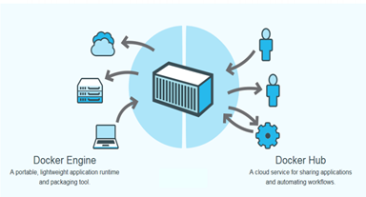
Docker
Open platform for developers and system administrators to build and test cloud applications

Slide 4
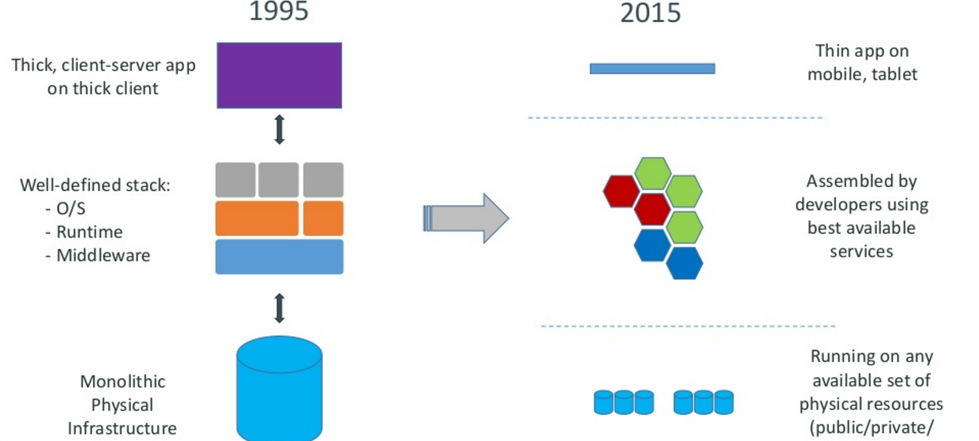
Motivation

Slide 5
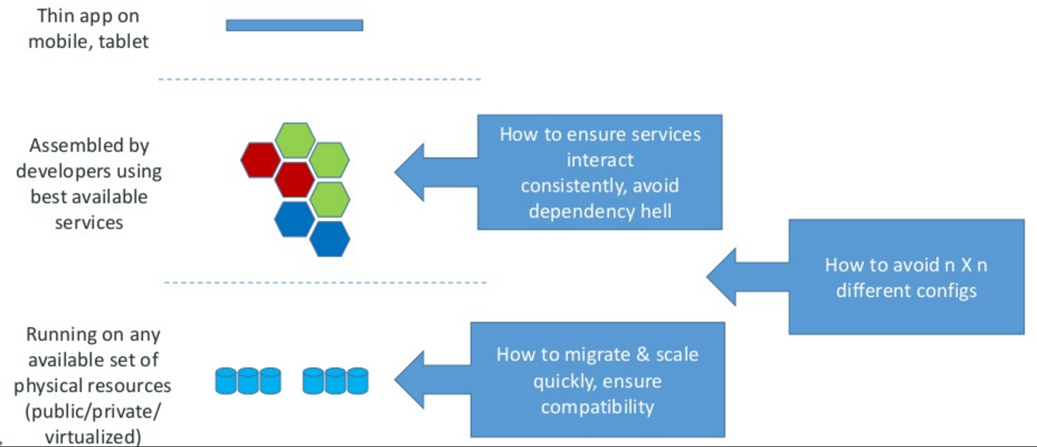
Motivation –the challenge

Slide 6
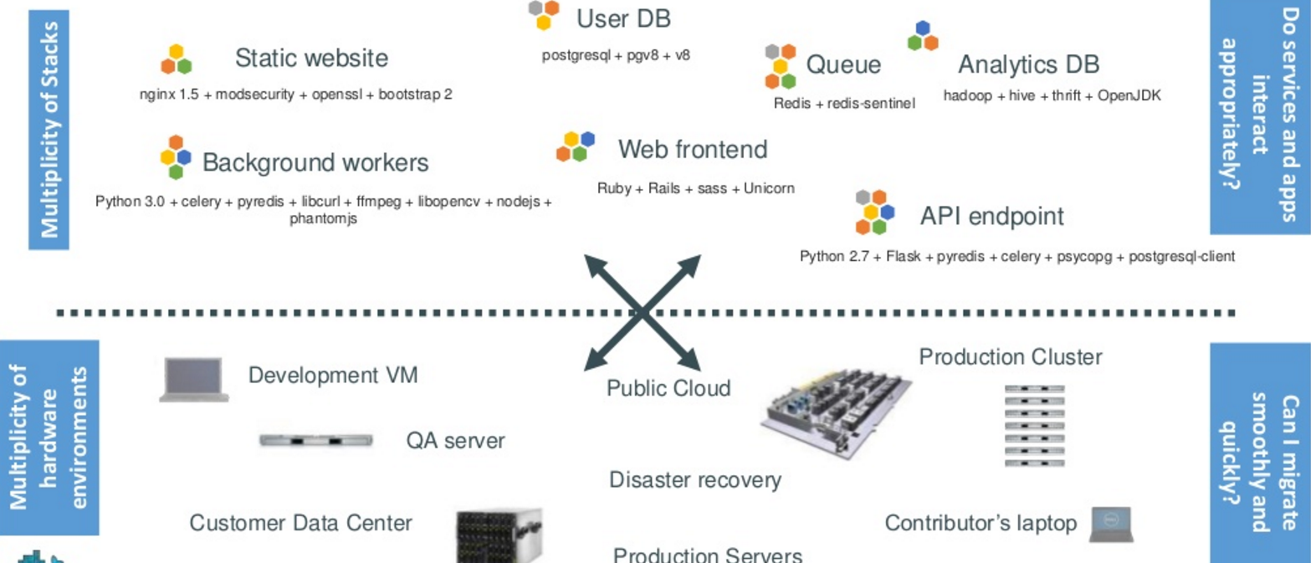
The challenge continued

Slide 7
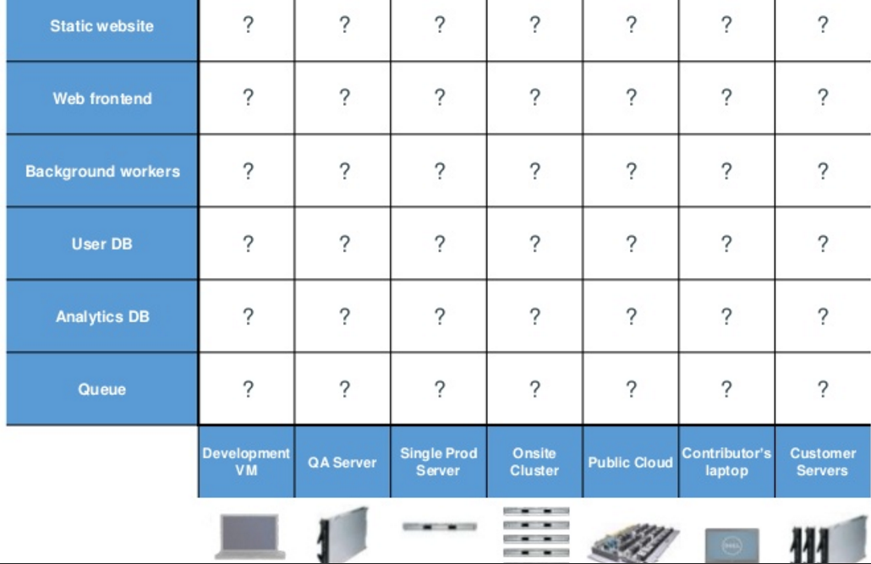
Looking for all kinds of solutions…
Too many to consider

Slide 8
THE ANSWER
Something called a CONTAINER ----which is the business Docker has created.

Slide 9
Huh??? Container
Here is an analogy that Docker use’s to let you understand….

Slide 10
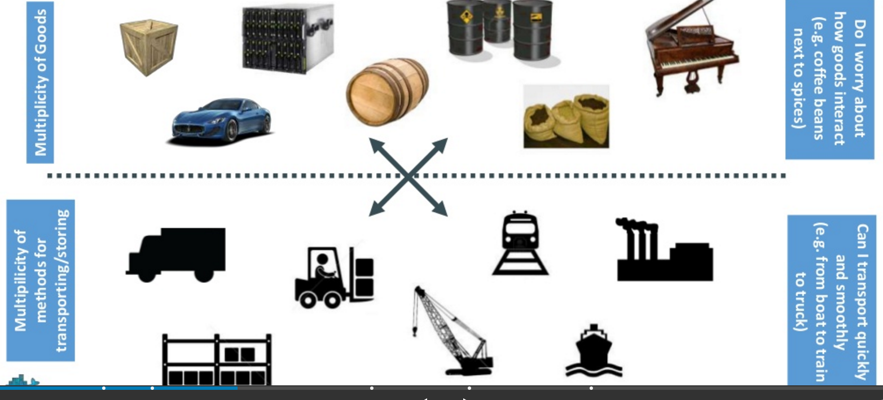
Understanding….an analogy …cargo transport pre-1960

Slide 11
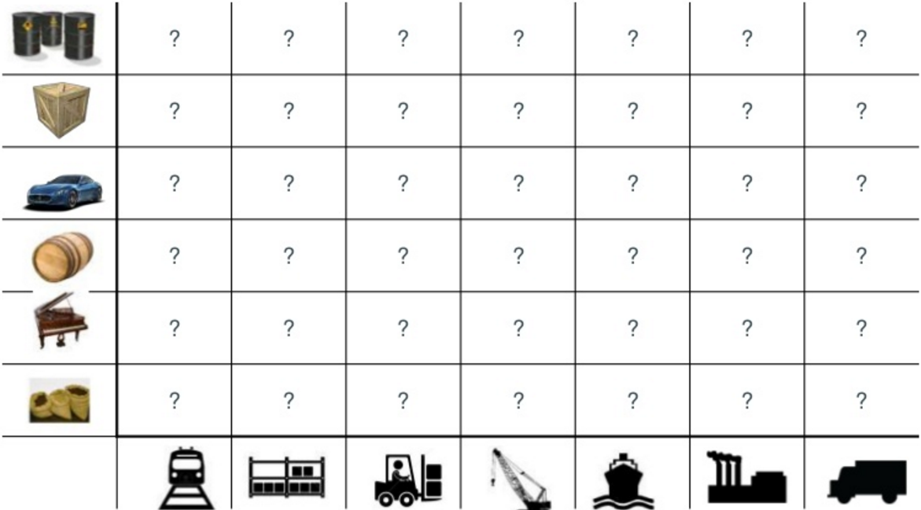
What are the possibilities

Slide 12
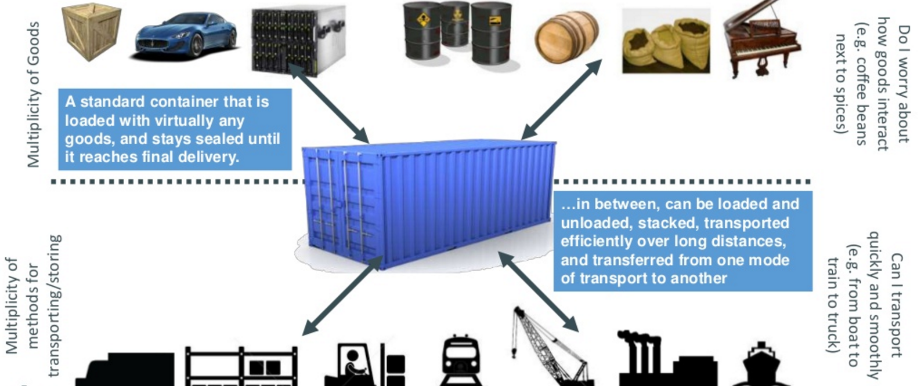
SOLUTION—shipping containers

Slide 13
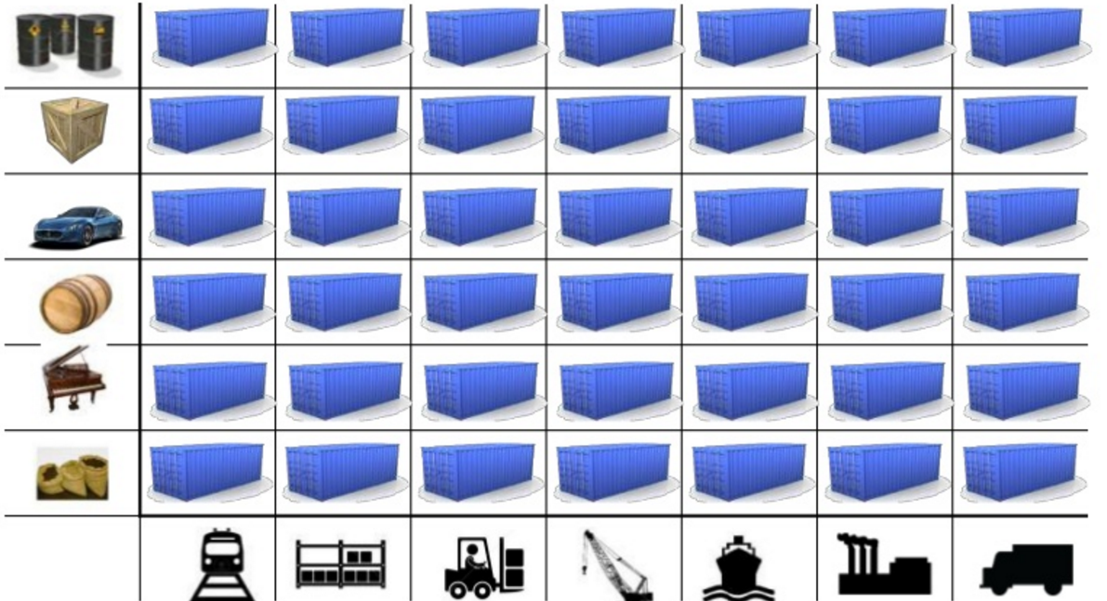
This solved the problem

Slide 14
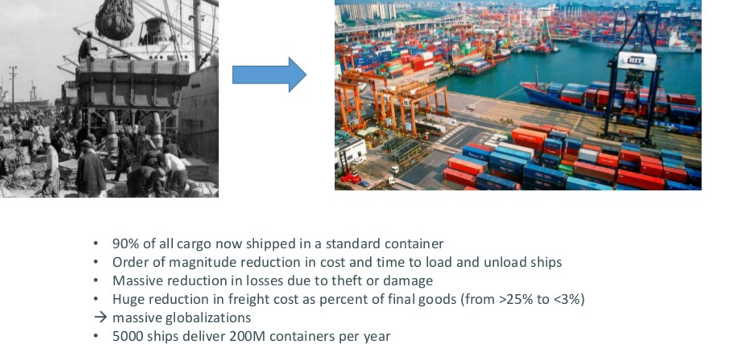
Today shipping is done with containers

Slide 15
How does this container idea translate to our problem

Slide 16
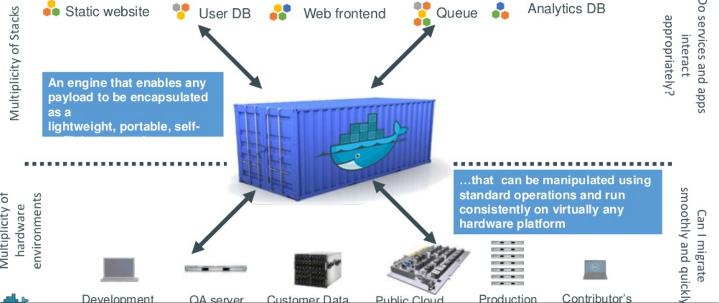
How does this container idea translate to our problem—container for code????

Slide 17
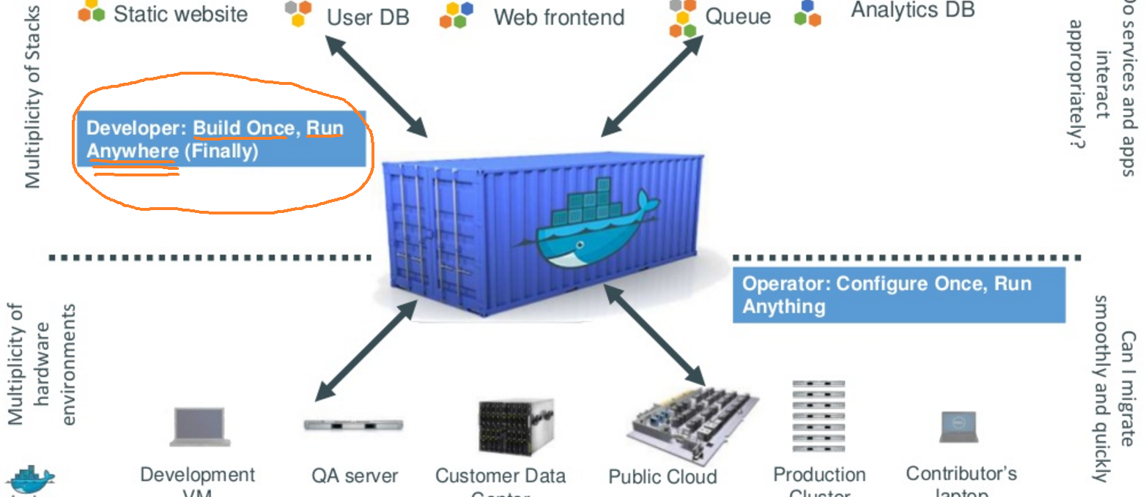
Do once run anywhere

Slide 18
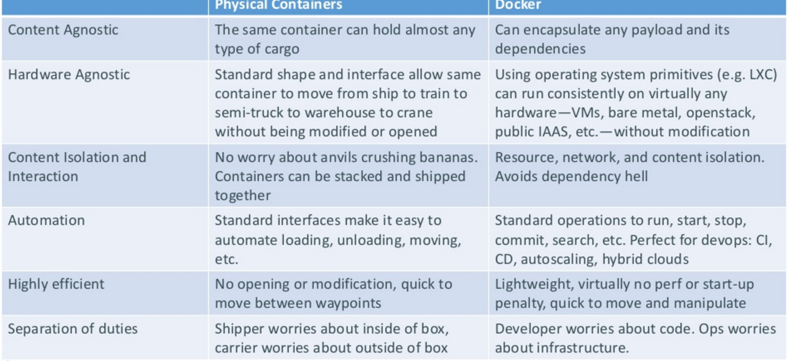
Docker’s container ---the concept (and relation to our shipping container)

Slide 19
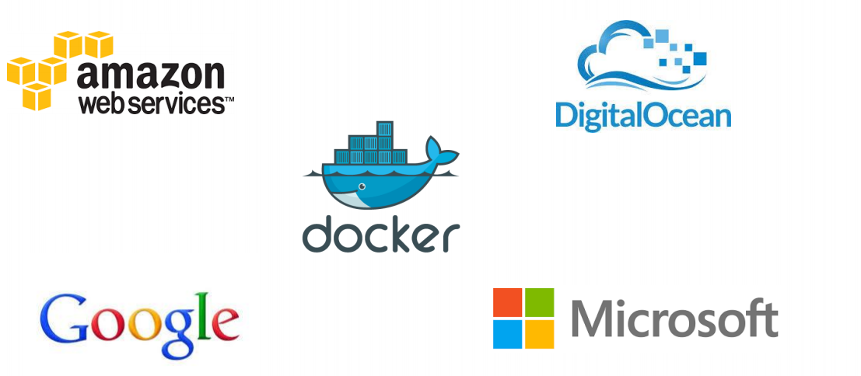
Docker supported in many Cloud platforms

Slide 20
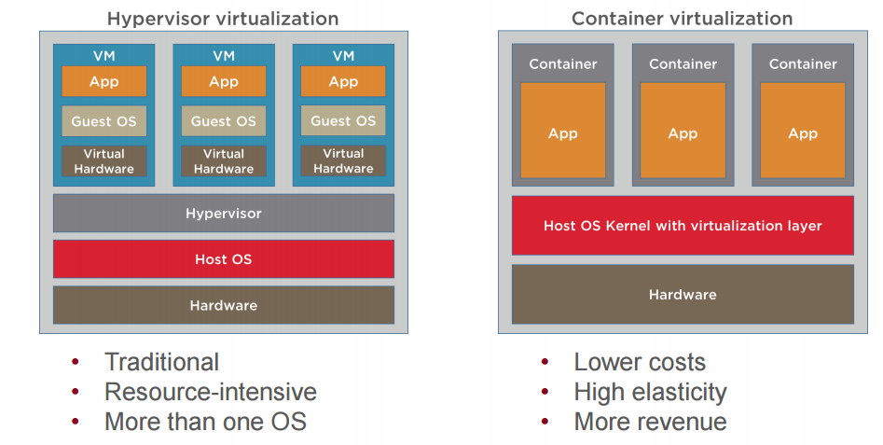
Containers versus VMs

Slide 21
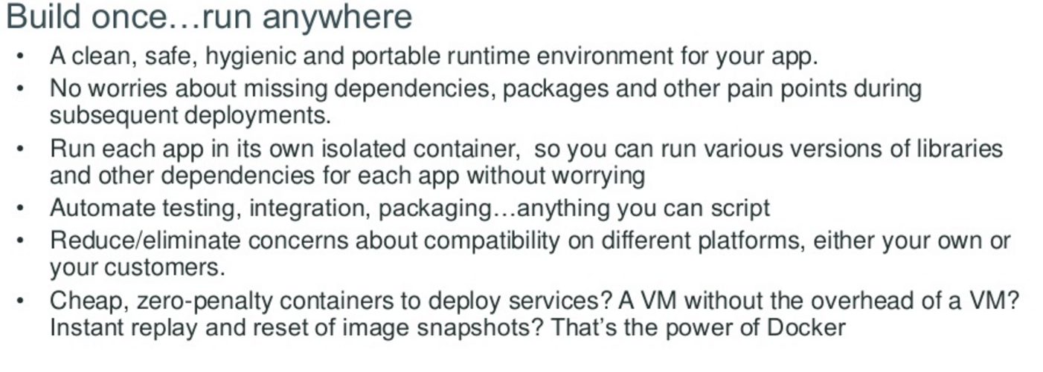
Docker container—developer viewpoint

Slide 22
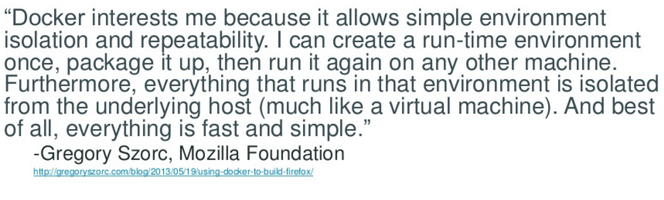
Developer viewpoint---(doesn’t this quote remind you of Java virtual machine)

Slide 23
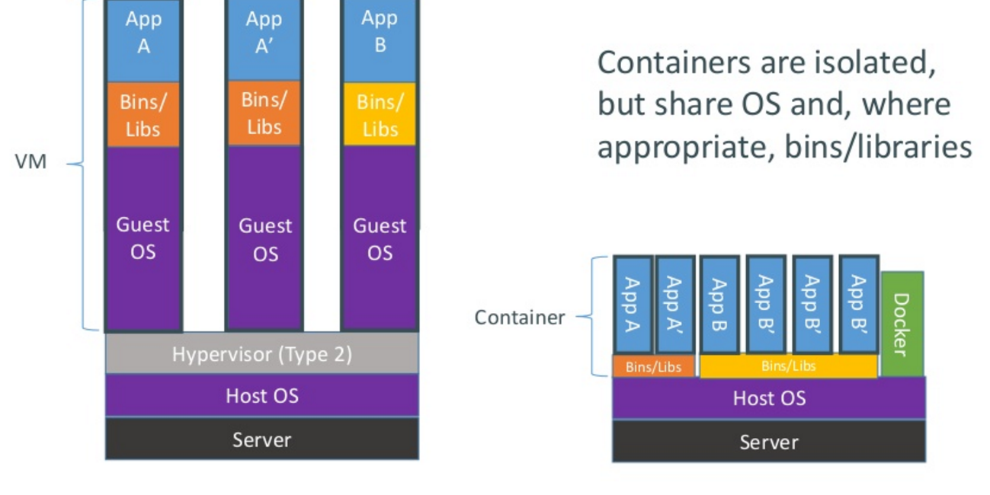
How does Docker containers work?

Slide 24
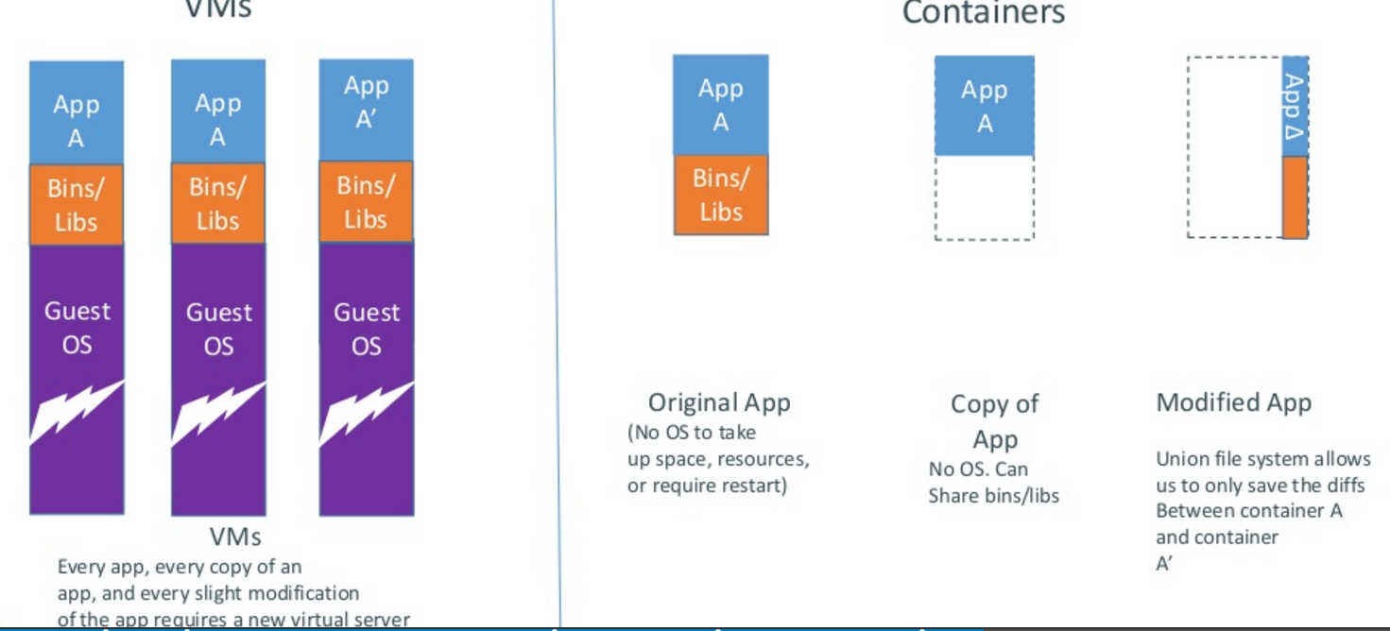
Docker containers are lightweight

Slide 25
WOW –is Docker a PaaS or a replacement for PaaS

Slide 26
Docker versus PaaS
FIRST doesn’t have to be a comparison..but…
For Docker: “In the case of PaaS you don’t have much control over many of the operational aspects associated with managing your application, for example the way it handles scaling, high availability, performance, monitoring, logging, updates. There is also a much stronger dependency on the platform provider in the choice of language and stack”
For PaaS, “PaaS offers additional benefits beyond application packaging and deployment, including service provisioning and binding, application monitoring and logging, automatic scaling, versioning and rollbacks, and provisioning across cloud availability zones,”

Slide 27
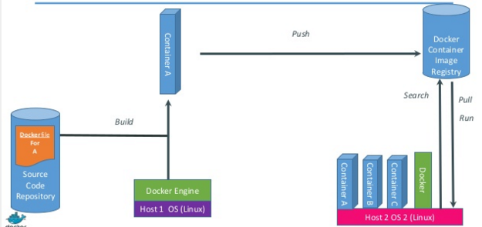
Just how does Docker work

Slide 28
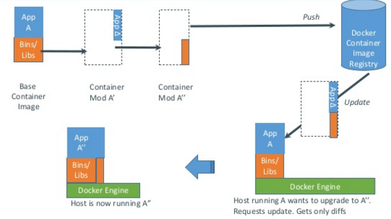
Docker updates/changes

Slide 29
Docker has a repository like github
you can push and pull container images to/from the Docker registry, which is something like a “GitHub” for Docker container images.

Slide 30
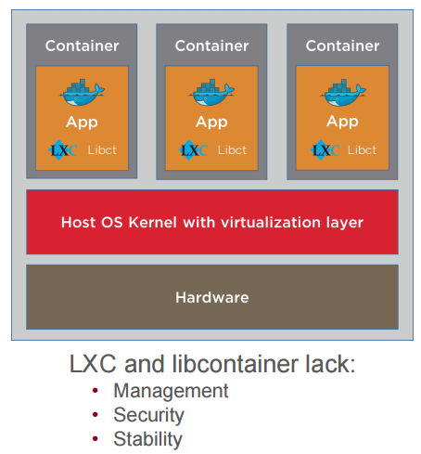
Service providers (public cloud) need containers to run Docker
Docker runs on Containers

Slide 31
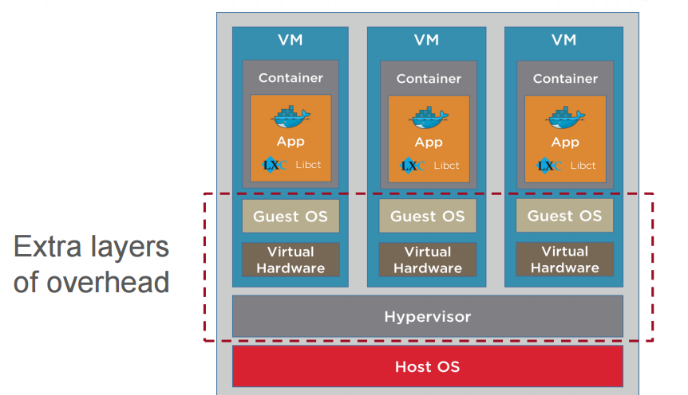
Open source Container inside VM Configuration

Slide 32
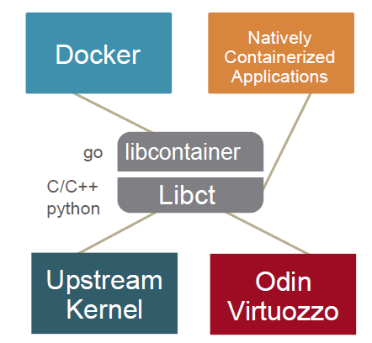
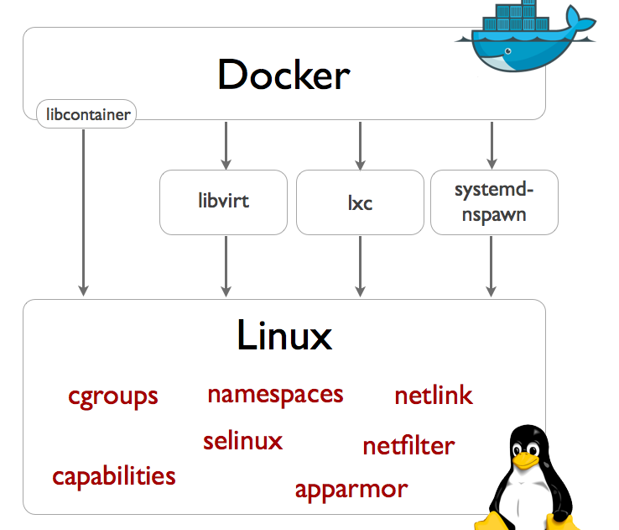
Docker needs containers
As mentioned, Docker has started the wave of new container technologies hitting the market
Odin is helping next ones get there by driving creation of libcontainer library

Slide 33
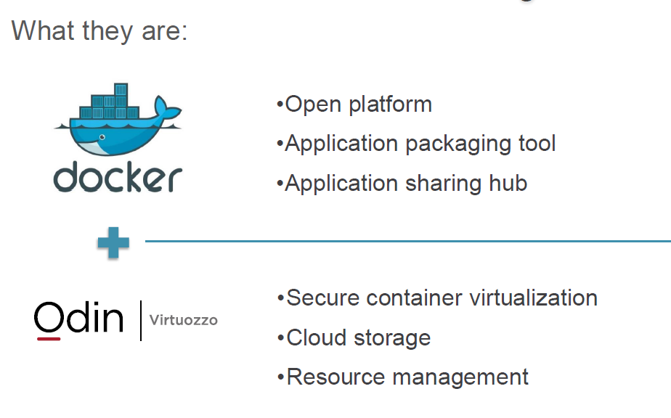
Virtuozzo provides container

Slide 34
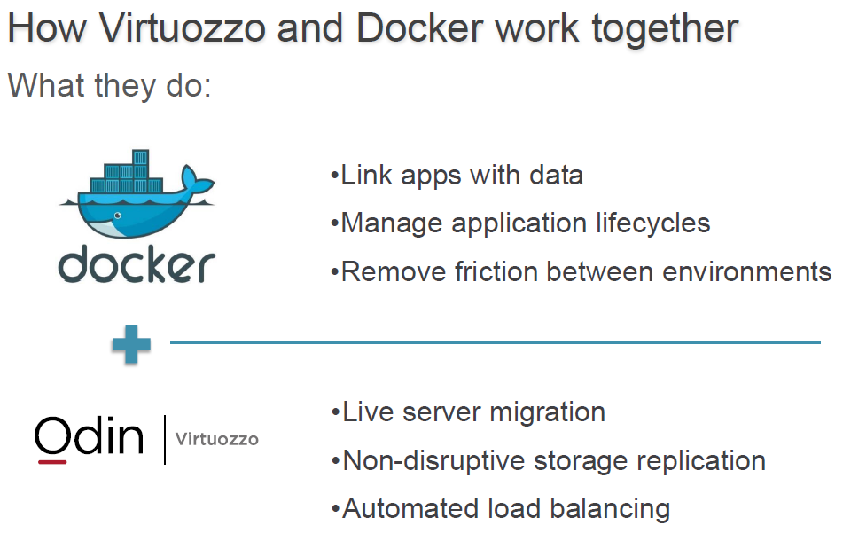
What they do

Slide 35
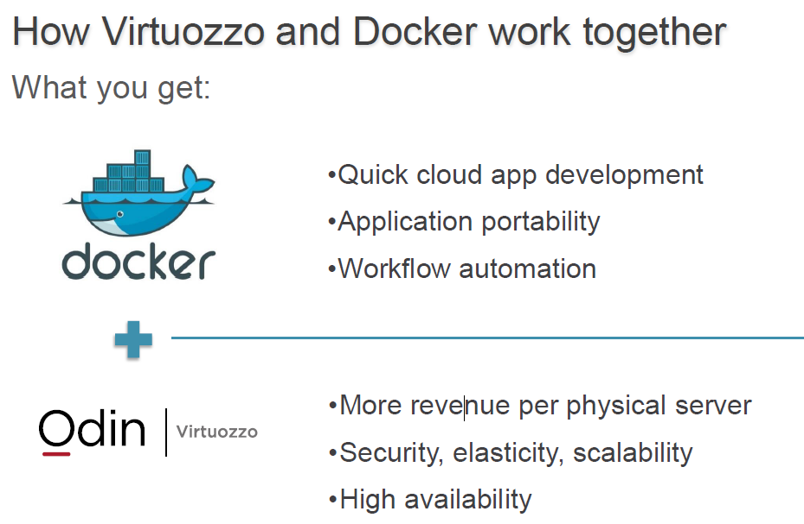
What you get

